Slide 1
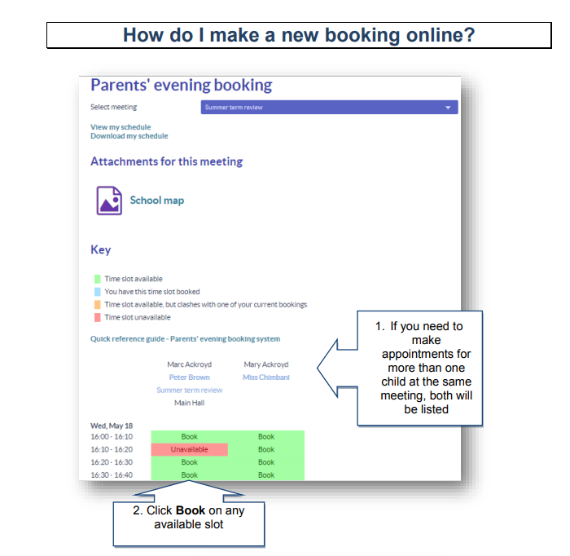
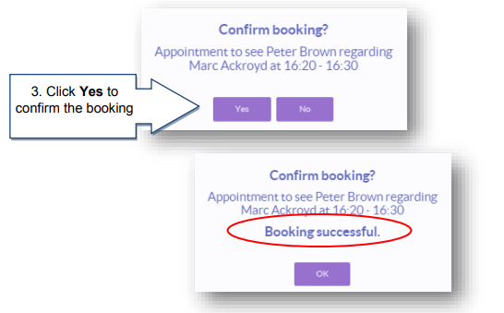
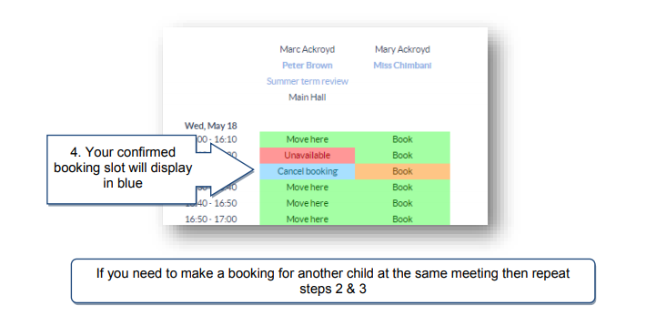
If you have not used the schools online payment system then please
follow the instructions below, if you have not received the instruction letter
Please visit the school office who can provide one for you.
ALEXANDRA PRIMARY SCHOOL
PARENT CONSULTATIONS – WEDNESDAY 13th February 2019 2PM – 7PM
SCHOOL WILL FINISH AT 1:45PM ON THIS DAY
Parent consultations will take place on Wednesday 13th February starting at 2pm.
We have introduced an online booking system for parents to book an appointment.
Please follow the instructions below to make your booking; if you require support to make your booking please speak to Heidi or Fiona in the office who can assist in this process.

Slide 2
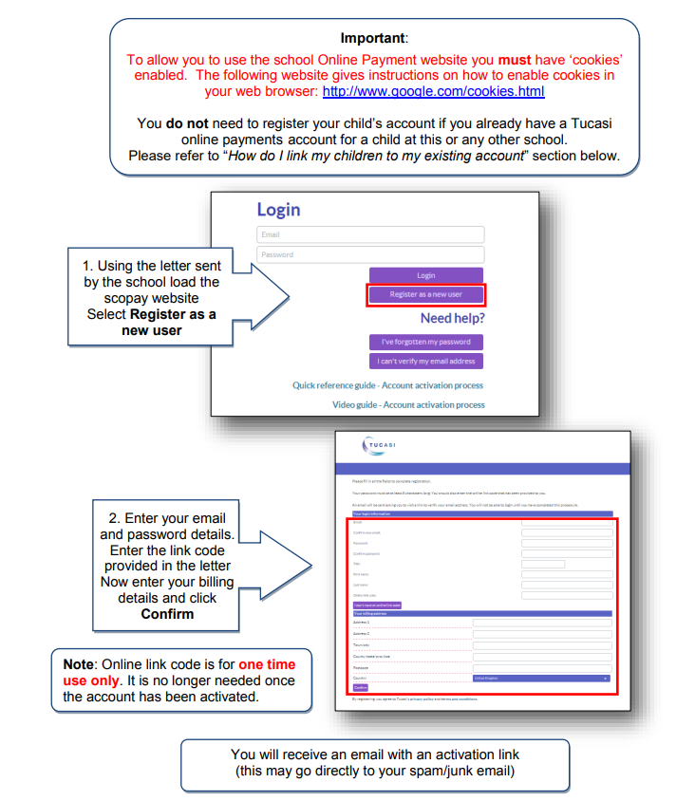
HOW DO I REGISTER MY CHILD’S ACCOUNT?
If you have not used the schools online payment system, please follow the instructions below.
If you have not received the instruction letter please visit the school office where one can be given to you.

